Slide 1
Ecosystems: Lesson 4, Activity 1
Why are carbon pools different sizes?

Slide 2
Why are carbon pools different sizes?
Sunny Meadows and the Carbon Dice Game showed the same pattern of carbon pool sizes in the ecosystem:
Producers larger than
Herbivores larger than Carnivores.
Why?

Slide 3
Tracking Carbon Atoms
Each square is 100 carbon atoms

Slide 4
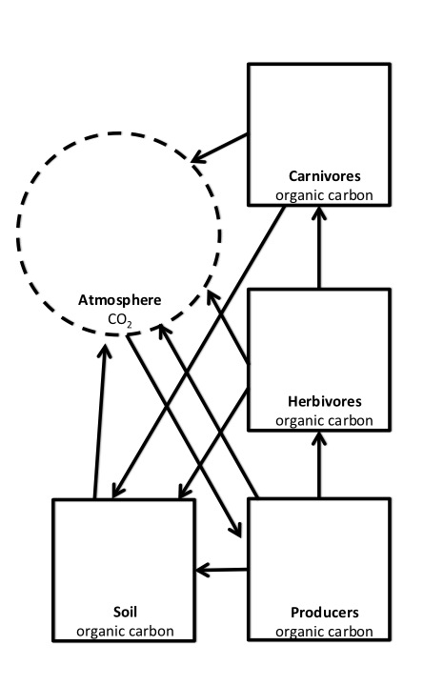
You will keep track of two types of numbers:
The number of carbon atoms that moved
The number of carbon atoms that stayed

Slide 5
For example:
50
The number of carbon atoms that moved
The number of carbon atoms that stayed
50
100 -50
= 50 left

Slide 6
Also, write the process that occurred near each arrow.
50
eating
50
100 -50
= 50 left

Slide 7
Plant photosynthesis occurred, so there are 500 carbon atoms are in the producer pool.
500

Slide 8
Plant cellular respiration occurs.
200 carbon atoms move from the producers to the atmosphere.
200
200
Write down the number of carbon atoms that moved.
500
-200
Keep track of the number of carbon atoms that stayed.

Slide 9
Some plants die.
100 carbon atoms move from the producers to the soil.
200
200
Write down the number of carbon atoms that moved.
100
500
-200
Keep track of the number of carbon atoms that stayed.
-100
100

Slide 10
Plants get eaten by rabbits!
100 carbon atoms move from the producers to the herbivore pool.
200
100
200
100
Write down the number of carbon atoms that moved.
100
500
-200
Keep track of the number of carbon atoms that stayed.
-100
100
-100

Slide 11
One of three things can happen to food (grass) in a rabbit’s stomach:
1) Rabbits digest the food & do cellular respiration.
50 carbon atoms move from the herbivores to the atmosphere.
200
+50
100
50
-50
200
100
Write down the number of carbon atoms that moved.
100
500
-200
Keep track of the number of carbon atoms that stayed.
-100
100
-100

Slide 12
One of three things can happen to food (grass) in a rabbit’s stomach:
2) Rabbits defecate indigestible food.
Also, sometimes rabbits die.
25 carbon atoms move from the herbivores to soil.
200
+50
100
50
-50
-25
200
25
100
Write down the number of carbon atoms that moved.
100
500
+25
-200
Keep track of the number of carbon atoms that stayed.
-100
100
-100

Slide 13
One of three things can happen to food (grass) in a rabbit’s stomach:
3) Rabbits digest & biosynthesize
Large molecules in grass are broken down into small molecules.
Small molecules are made into rabbit biomass.
200
+50
100
50
-50
-25
200
25
100
100
500
+25
-200
-100
100
-100

Slide 14
Rabbits got eaten by foxes!
15 carbon atoms move from the herbivores to carnivores.
15
200
+50
15
100
50
-50
-25
200
-15
25
100
Write down the number of carbon atoms that moved.
100
500
+25
-200
Keep track of the number of carbon atoms that stayed.
-100
100
-100

Slide 15
One of three things can happen to food (rabbits) in a fox’s stomach:
1) Foxes digest the food & do cellular respiration.
6 carbon atoms move from the carnivores to the atmosphere.
15
-6
6
200
+50
+6
15
100
50
-50
-25
200
-15
25
100
Write down the number of carbon atoms that moved.
100
500
+25
-200
Keep track of the number of carbon atoms that stayed.
-100
100
-100

Slide 16
One of three things can happen to food (rabbits) in a fox’s stomach:
2) Foxes defecate indigestible food.
Also, sometimes foxes die.
6 carbon atoms move from the carnivores to the soil.
15
-6
-6
6
200
+50
+6
6
15
100
50
-50
-25
200
-15
25
100
Write down the number of carbon atoms that moved.
100
500
+25
-200
Keep track of the number of carbon atoms that stayed.
+6
-100
100
-100

Slide 17
One of three things can happen to food (rabbits) in a fox’s stomach:
3) Foxes digest the food & biosynthesize
Large molecules in rabbits are broken down into small molecules.
Small molecules are made into fox biomass.
15
-6
-6
6
200
+50
+6
6
15
100
50
-50
-25
200
-15
25
100
100
500
+25
-200
+6
-100
100
-100

Slide 18
Decomposers that live in the soil digest organic carbon and respire.
64 carbon atoms move from the soil to the atmosphere.
15
-6
-6
6
200
+50
+6
6
+64
15
100
50
-50
-25
200
-15
64
25
100
Write down the number of carbon atoms that moved.
100
500
+25
-200
Keep track of the number of carbon atoms that stayed.
+6
-100
-64
100
-100

Slide 19
Do the math!!
What is the total amount of carbon atoms in each pool?
15
-6
-6
6
200
+50
+6
6
+64
15
100
50
-50
-25
200
-15
64
25
100
100
500
+25
-200
+6
-100
-64
100
-100

Slide 20
Do the math!!
What is the total amount of carbon atoms in each pool?
15
-6
-6
6
=3
200
+50
+6
6
+64
15
=320
100
50
-50
-25
200
-15
=10
64
25
100
100
500
+25
-200
+6
-100
-64
100
-100
=67
=100

Slide 21
Do the math!!
What is the total amount of carbon atoms in each pool?
3
6
6
15
320
50
10
200
64
25
100
67
100
100

Slide 22
For all the carbon atoms in the producers that become organic matter through photosynthesis, where do most of the carbon atoms go? Why?
3
6
6
15
320
50
10
200
64
25
100
67
100
100
Notes:
Most of the carbon atoms go to the atmosphere. This is because the organism is doing cellular respiration. The organism needs a lot of energy to do it’s life processes, so most of the food made by plants (or eaten by animals) is burned in cellular respiration in order to use chemical energy.

Slide 23
For all the carbon atoms in the organic matter (grass) that are digested by rabbits in the herbivore pool, where do most of the carbon atoms go? Why?
3
6
6
15
320
50
10
200
64
25
100
67
100
100
Notes:
Most of the carbon atoms go to the atmosphere. This is because the organism is doing cellular respiration. The organism needs a lot of energy to do it’s life processes, so most of the food made by plants (or eaten by animals) is burned in cellular respiration in order to use chemical energy.

Slide 24
Why does this pattern of relative pools sizes exist in ecosystems?
Does it have anything to do with energy?
3
6
6
15
320
50
10
200
64
25
100
67
100
100
Notes:
Cellular respiration occurs, so much of the carbon returns to the atmosphere while organisms are alive.
(AND, animals are inefficient in the food that they eat. They only digest and use some of the carbon that they consume.)

